Slide 1
ACCREDITATION
CANADA
INTERNATIONAL
Required Organizational Practices

Slide 2
WORKLIFE /
WORKFORCE
Create a work life and physical environment
that supports the safe delivery of care and
service.
OUTLINE :
Preventive maintenance program
Patient safety Education and training
Patient safety plan
Workforce violence prevention
Client flow

Slide 3
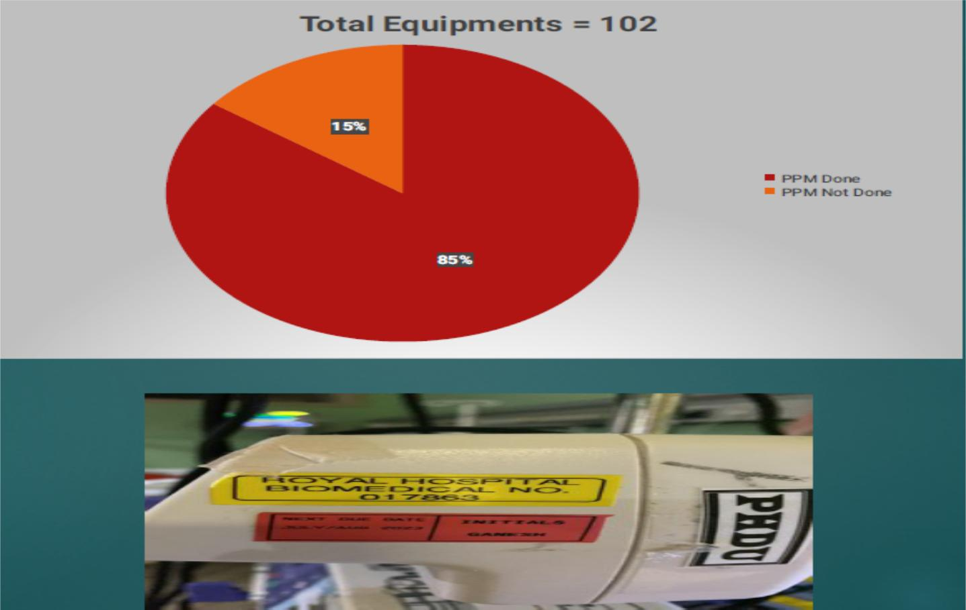
Preventive Maintenance Program

Slide 4
PATIENT SAFETY:
EDUCATION & TRAINING
FOCUS AREAS:
Safe medication use
Reporting safety incidents
Techniques for effective communication
Hand washing and hand hygiene
Infection prevention and control
Equipment and facility sterilization

Slide 5
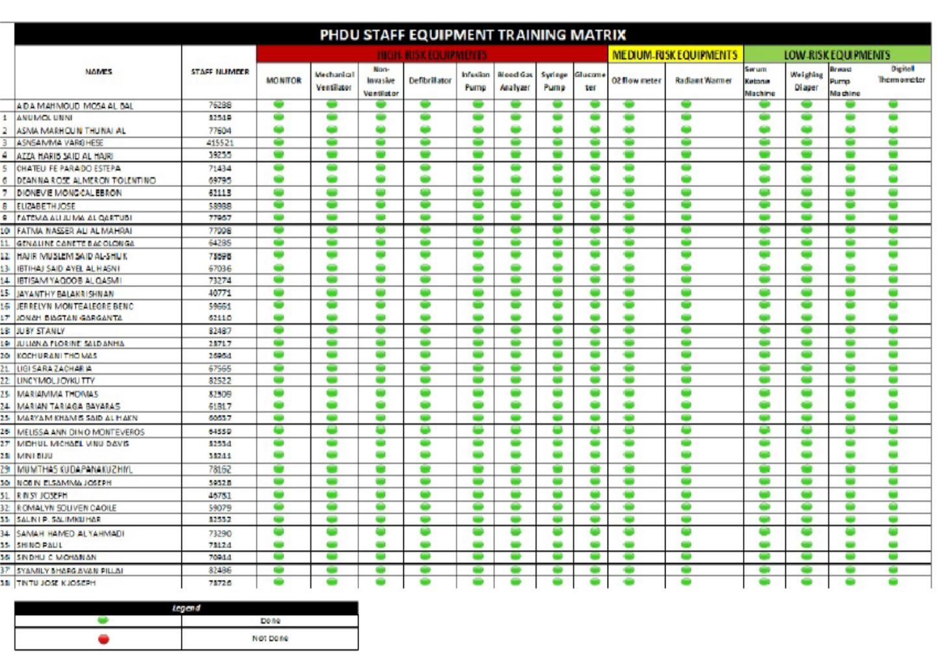

Slide 6
CLIENT SAFETY PLAN:
The organizations develops and implements
a client safety plan, and implements improvements to client safety as required
.
CLIENT SAFETY:
ROLES & RESPONSIBILITIES
The organization clearly defines the roles,
responsibilities, and accountabilities of
leader, staff, service providers, and volunteers for client care and safety.
.

Slide 7
INT’L PATIENT SAFETY
GOALS:
1. Identify patients correctly
2. Improve effective communication.
3. Improve the safety of high- alert
medications.
4. Ensure safe surgery
5. Reduce the risk of health care
associated infections

Slide 8
WORKPLACE VIOLENCE
PREVENTION
The organization prevents workplace violence
4 classifications of workplace
violence:
1. CRIMINAL INTENT- Perpetrator has no
relationship to the workplace
2. CLIENT OR CUSTOMER –a client, visitor
or family member of a client at the worplace
3. WORKER-TO-WORKER --- a perpetrator is
an employee or past employee of the worplace
4. PERSONAL RELATIONSHIP – a perpetrator
has a relationship w/ an employee
.

Slide 9
CODE WHITE
Prior to initiating Code White, the senior most staff present on site should:
Find out why the abusive or aggressive
person is upset or angry.
ꢀBe non-confrontational
ꢀTry to disffuse the situation by employing
interpersonal and communications skills
ꢀCall the Patient Services Officer (PSO) or
Duty Director to deal with the person

Slide 10
ꢀIn instances where it is desired
that a disruptive but non-threatening
person leave the hospital premises,
the Security officer should be
present to lend authority to the
request that the person leave.

Slide 11
When to activate Code White ?
ꢀA suspicious person is found loitering
around.
ꢀA person under the obvious influence of
alcohol or drugs refuses to leave
immediately when told.
ꢀAn outsider is found trying to
impersonate a doctor or any other staff.
ꢀA person is trying to abduct a baby or
child
ꢀA person is found stalking or attempting
to molest a lady

Slide 12
To activate "CODE WHITE”
dial 9111
ꢀ State your exact location of incident
ꢀ Nature of incident
ꢀ Your name and designation.
THE IN - CHARGE
Log an incident report
mention if there more than 5
minutes delay the Code White team
members arriving on the scene.

Slide 13
STAFF PRESENT IN THE SCENE:
ꢀRemain calm, cautious and courteous;
be assertive, not aggressive, avoid
creating panic.
ꢀConverse and answer questions
courteously.
ꢀIn the case of multiple offenders are
involved, staff of the adjacent areas
shloud lock doors & stay out of the
danger area.
ꢀTake note of the appearance, clothing,
age & identifying marks of the
aggressor;

Slide 14
ꢀIf assailant flees, make a note of routes
taken, vehicle details and any other
pertinent info
ꢀEnsure the phone line is kept open.
CLIENT FLOW :
1. Starts from the decision made
2. Time the bed manager inform
3. Bed allocation
4. Time patient shifted.

Slide 15
CLIENT FLOW

